Slide 1
SIMPLE REGRESSION
by
Dr. Srinibash Dash
Associate Professor & Head
School of Management
Gangadhar Meher University
)

Slide 2
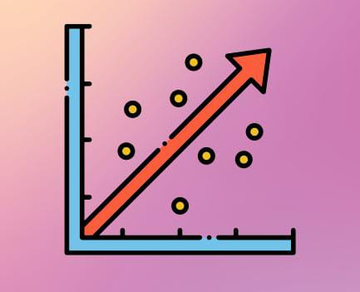
Contents
Introduction
Objectives
Types
Graph
Example on Simple Regression
Assumptions
Conclusion

Slide 3
What is Simple Regression?
Simple Regression was introduced by a British mathematician, Sir Francis Galton (19th century).
It is a statistical tool that gives us the ability to estimate the mathematical relationship between a dependent variable and an independent variable.
The relationship between the variables is typically represented by a straight line equation where the independent variable is on x-axis and dependent variable is on y-axis.
It aims to understand how changes in the independent variable affect the dependent variable

Slide 4
Objectives of Simple Regression
Quantify Relationship: It determines how changes in the independent variable affect the dependent variable.
Predictive Modeling: It helps to predict the values of the dependent variable based on the values of the independent variable.
Model Interpretation: It creates linear equation that represents this relationship mathematically.
Parameter Estimation: These objective includes estimating the parameters of the regression equation, such as the slope and intercept, to minimize the errors between the observed and predicted values.
Assessing Verification: It ensure that regression analysis such as linearity, homoscedasticity and independence are met for reliable results.

Slide 5
Understanding Variability: It helps in understanding the variability in the dependent variable that can be explained by changes in the independent variable versus the variability that cannot be explained by the model.
Model Validation: It adequately represents the relationship between the variables and provides accurate predictions.
Identifying Outliers: Simple regression can help in identifying influential points that may have a disproportionate impact on the regression results.
Model Comparison: Comparing different regression models to determine which one best fits the data and provides the most accurate predictions.
Inference: Drawing conclusions about the population based on the sample data, such as making inferences about the relationship between the variables in the larger population.

Slide 6
Types of Simple Regression
Simple Linear Regression
Simple Non Linear Regression
In simple regression, the relationship between the independent variable (x) and the dependent variable (y) is assumed to be linear.
The relationship is represented by a straight line equation, i.e., y = mx + b
m = slope of the line
b is the y-intercept.
These is a statistical method used to model the relationship between a dependent variables and one or more independent variables when the relationship is not linear.
It fits a curve or a more complex function to the data.

Slide 7
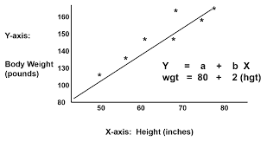
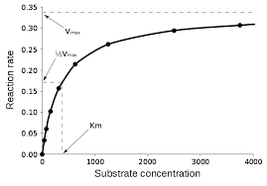
Simple linear regression
Simple non linear regression

Slide 8
Example: From the given data calculate regression equation taking deviation of item from the mean of x and y axis
X | 1 | 3 | 5 | 7 | 9 | 4 | 6
Y | 2 | 4 | 3 | 7 | 5 | 6 | 1

Slide 9
X | Y | X=X-X | Y=Y-Y | X² | Y² | X.Y
1 | 2 | -4 | -2 | 16 | 4 | 8
3 | 4 | -2 | 0 | 4 | 0 | 0
5 | 3 | 0 | -1 | 0 | 1 | 0
7 | 7 | 2 | 3 | 4 | 9 | 6
9 | 5 | 4 | 1 | 16 | 1 | 4
4 | 6 | -1 | 2 | 1 | 4 | -2
6 | 1 | 1 | -3 | 1 | 9 | -3
Σx = 35 | Σy = 28 |  |  | ΣX² = 42 | ΣY² = 28 | ΣX.Y = 13
X = ΣX/N = 35/7 = 5 Y = ΣY/N = 28/7 = 4

Slide 10
Regression equation of X on Y ,
x-x = bxy (y-y) [ bxy = Σxy/Σy = 13/28 = 0.46]
x-5 = 0.46 (y-4)
x = 0.46y – 1.84 + 5
x = 0.46y + 3.16
Regression equation of Y on X ,
y-y = byx (x-x) [ byx = Σxy/Σx = 13/42 = 0.31 ]
y-4 = 0.31 (x-5)
y = 0.31x - 1.55 + 4
y = 0.31x + 2.45

Slide 11
Assumptions on Simple Regression
Linearity: There should be a linear relationship between the independent variable (X) and the dependent variable (Y).
Independence: The observations are independent of each others.
Homoscedasticity: The variance of the errors (residuals) is constant across all levels of the independent variable.
Normality of Residuals: The residuals (the differences between the observed values and the predicted values) are normally distributed. This assumption ensures that the statistical tests and confidence intervals based on the normal distribution are valid.
No Perfect Multicollinearity: There should not be perfect linear relationships among the independent variables.

Slide 12
Conclusion
In conclusion, simple regression is a powerful statistical method for understanding the relationship between two variables. It provides valuable insights into how changes in one variable affect another and allows for predictions based on this relationship. However, it's essential to assess the model's goodness of fit and consider potential limitations such as assumptions and outliers. Overall, simple regression is a fundamental tool in data analysis and prediction.

Slide 13
THANK YOU

